Slide 1
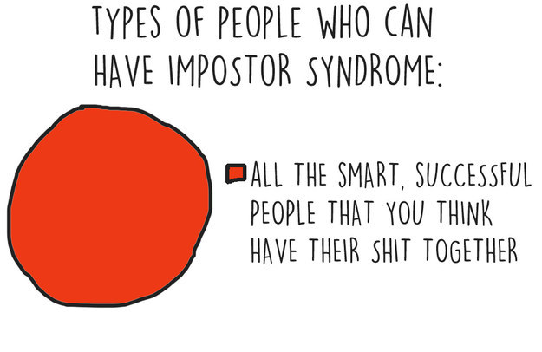
**
Dr Bex Hemmingson
Remix Coaching and Consulting
E: rebecca@remixcoaching.com
MSD Women’s Network
Friday August 24th, 2018

Slide 2
What is it?
Where does it come from?
Do I have it?
What can I do about it?
How does it show up for me?

Slide 4
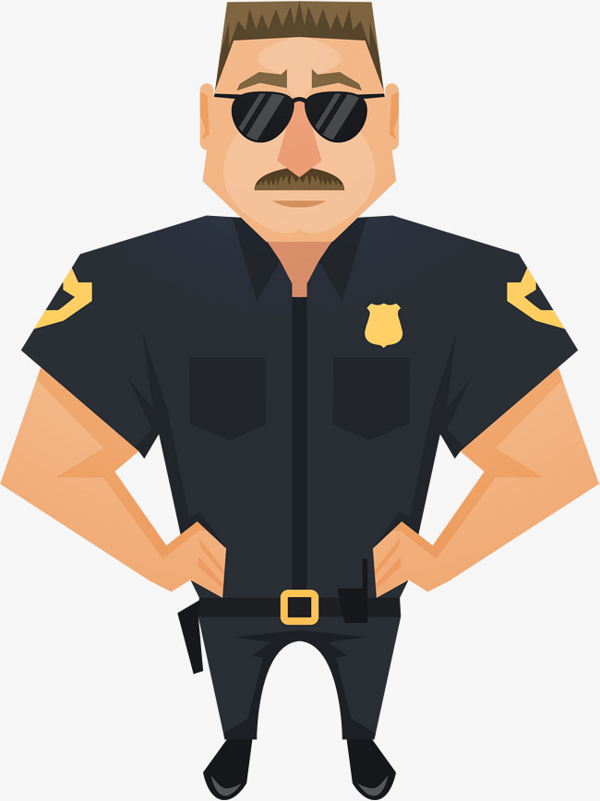
A psychological pattern in which people doubt their accomplishments and have a persistent fear of the talent police showing up and being exposed as a fraud
(...despite LOADS of evidence to the contrary!)

Slide 5
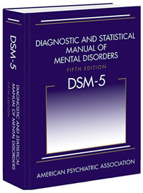
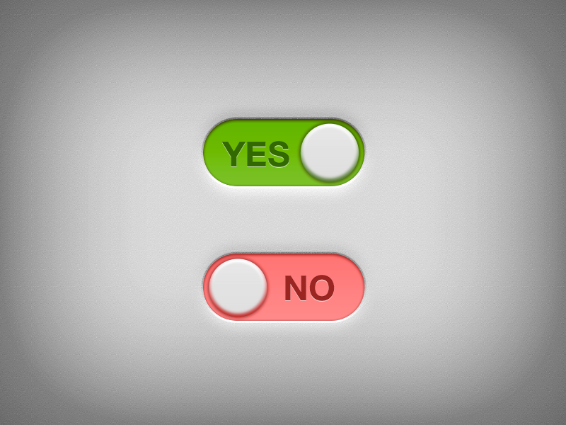
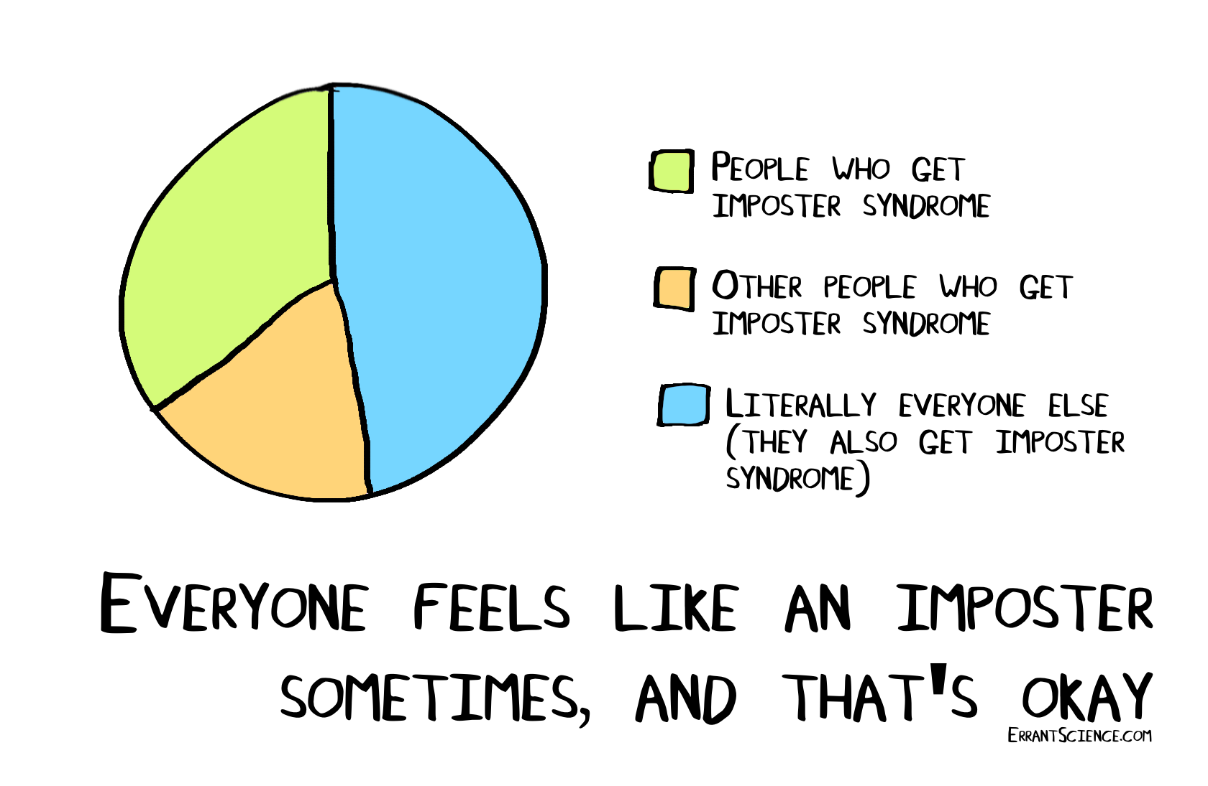
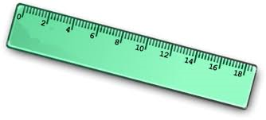

Slide 6
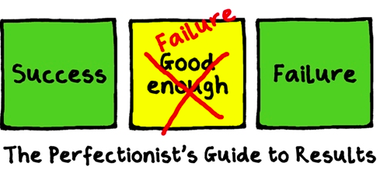
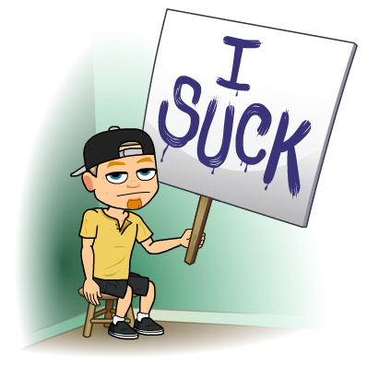
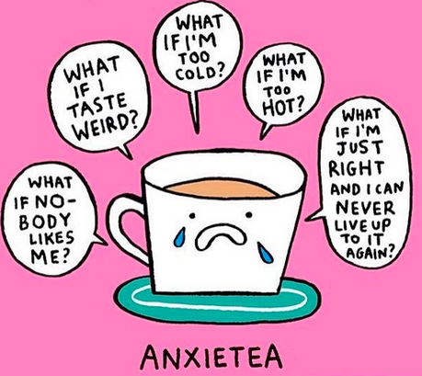
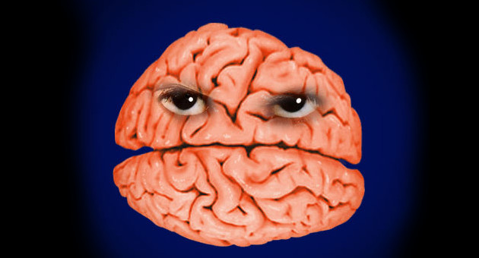

Slide 7
Which statements resonate for you? …

Slide 8
I often have difficulty delegating
I feel like my work should be 100% perfect, 100% of the time
If I miss the mark on something, I ruminate about it for days and tell myself I’m not cut out for this!

Slide 9
When I’m faced with a setback my confidence drops; I feel a sense of shame that I haven’t performed well
I find new challenges uncomfortable because I worry I might not be good at the new thing I’m trying

Slide 10
I feel that I should be able to accomplish things on my own
If I need a mentor to help me then it’s not really my achievement

Slide 11
I shy away from applying for jobs unless I meet the majority of the requirements
I constantly seek out further training or certifications because I need to improve my skills in order to succeed
Even when I’ve been in a job role for a while, I still feel like I don’t know enough
I shudder if someone calls me an expert

Slide 12
Because I’m often working, my hobbies and passions has fallen by the wayside a little
Despite numerous achievements, I feel like I haven’t truly earned my title so feel pressured to work harder and longer to prove my worth
I get stressed when I’m not working and I find downtime wasteful

Slide 13
Perfectionist
“I should have done better. Mistakes are unacceptable”
(Young, 2011)

Slide 14
Natural Genius
“If I were really smart this would be effortless”
(Young, 2011)

Slide 15
Rugged Individualist
“The only achievements that really matter are the ones I got myself”
(Young, 2011)

Slide 16
Expert
“If I were actually smart, I’d know everything there is to know”
(Young, 2011)

Slide 17
Superhero
“If I were really competent, I’d be able to do it all”
(Young, 2011)

Slide 18
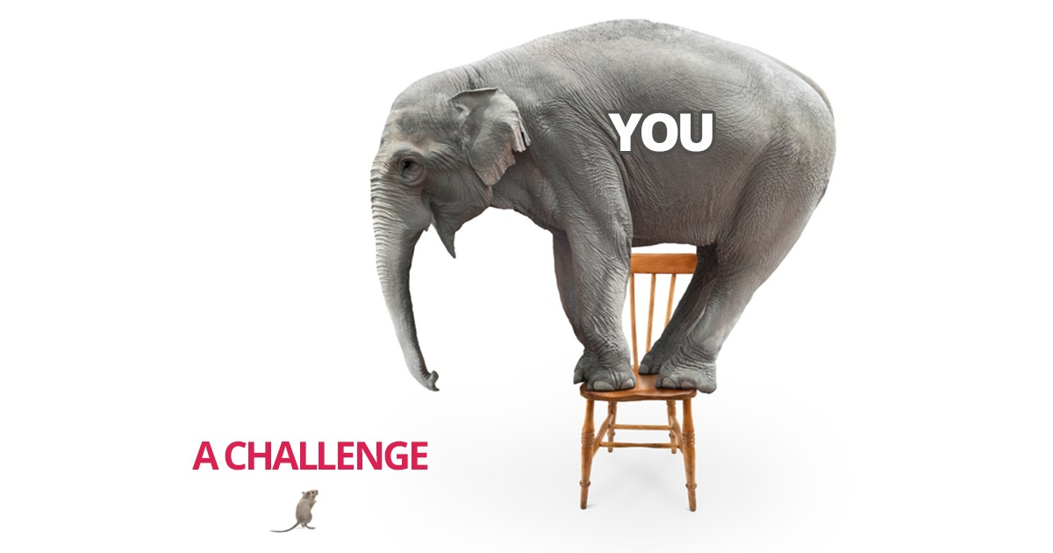

Slide 19
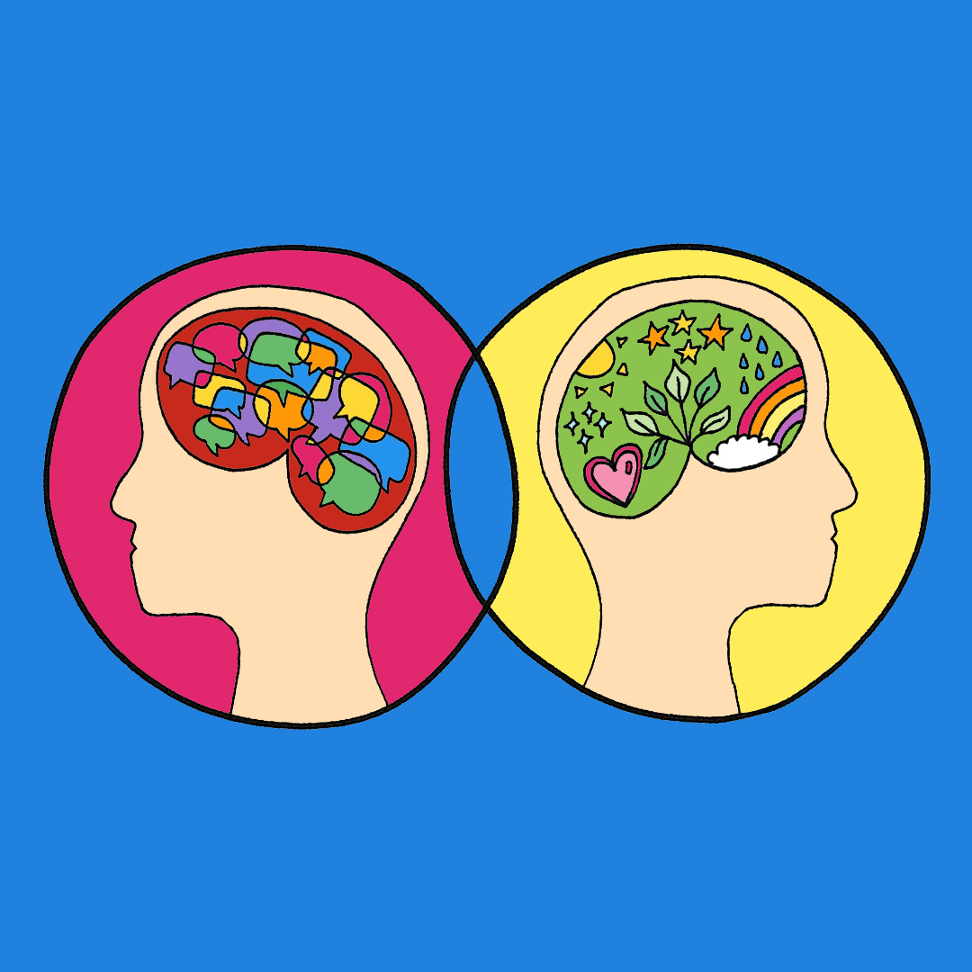
The first step to changing how we FEEL is changing how we THINK

Slide 20
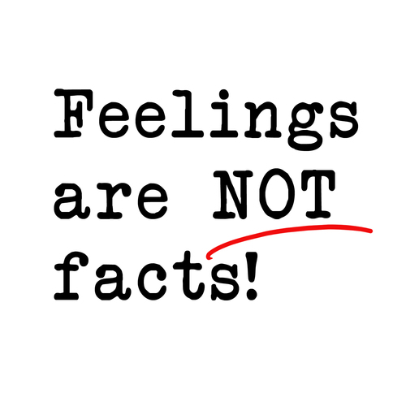
REMIX!

Slide 21
REMIX!

Slide 22
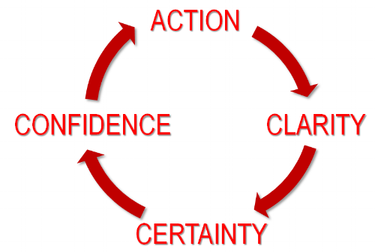
REMIX!

Slide 23
REMIX!

Slide 24
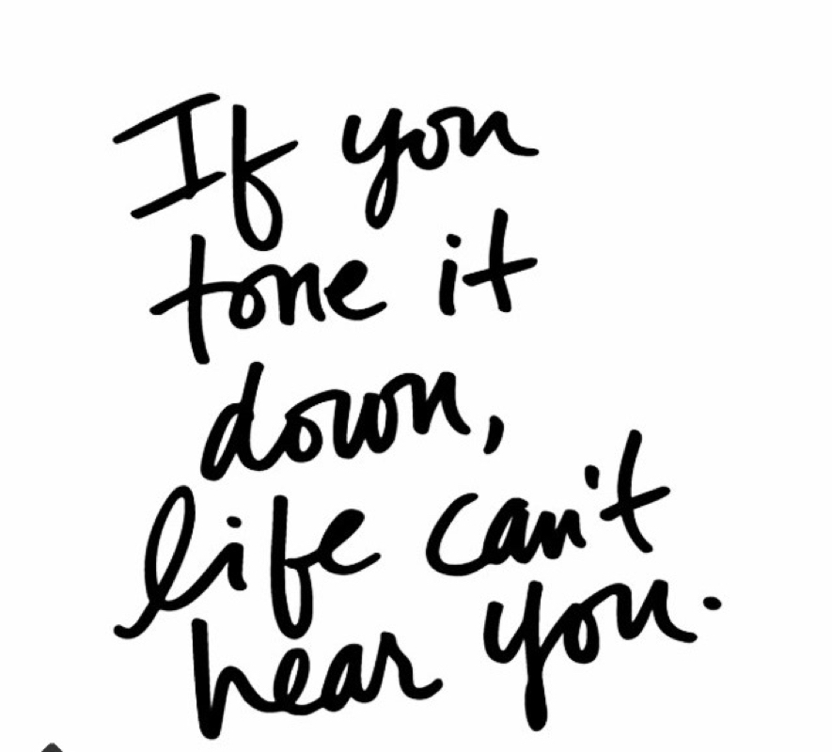
REMIX!

Slide 25
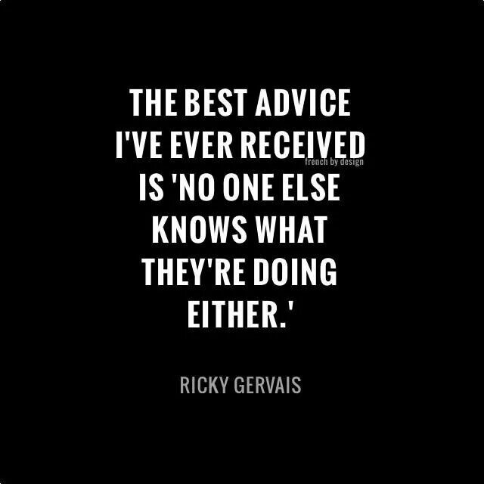
Thank you!
Oh, and a little something to always remember …

